Slide 1
Deep Neural Networks And Where to Find Them
Lecture 4
Artem Korenev, Nikita Gryaznov

Slide 2
Recap

Slide 3
Recap – Types of Problems and Losses
Most frequent problems:
Classification (predicting label(s) across the predefined set)
Losses:
Binary Cross Entropy (2 classes) or Categorical Cross Entropy (>2 classes)
(rarely) Hinge Loss
Regression (predicting real value without predefined set of outcomes)
Losses:
Mean Squared Error (L2 Loss)
Mean Absolute Error (L1 Loss)

Slide 4












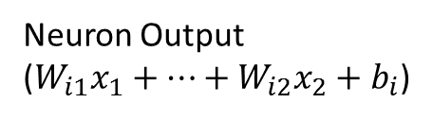
Recap – Dense Layer
Dense Layer
$x_{1}$
Layer input
$x_{1}$
$$W$$
Neuron Output
($W_{i1}x_{1}+…+W_{i2}x_{2}+b_{i}$)
$$f$$
$$x_{2}$$
Activation function
(Non-linearity)
(Neuron activation)
$$f$$
$$x_{3}$$
$$f$$
$$x_{4}$$
Layer weight
(trainable parameter)
$$f$$
$$b$$
$$1$$
Layer bias
(trainable parameter)

Slide 5





















Recap – Multi Layer Neural Network
Dense Layer
Dense Layer
Dense Layer
$x_{1}$
$$W_{1}$$
$$W_{2}$$
$$f$$
$$f$$
$$W_{3}$$
$$x_{2}$$
$$f$$
$$x_{3}$$
$$f$$
$$f$$
$$f$$
$$x_{4}$$
$$f$$
$$f$$
$$b_{1}$$
$$b_{2}$$
$$b_{3}$$
$$1$$
$$1$$
$$1$$

Slide 6







Recap – Regression Problem
Often no activation function is used!
Dense Layer
Dense Layer
Dense Layer
$x_{1}$
$$W_{1}$$
$$W_{2}$$
$$f$$
$$f$$
$$W_{3}$$
$$x_{2}$$
$$x_{3}$$
$$f$$
$$f$$
$$x_{4}$$
$$f$$
$$f$$
$$b_{1}$$
$$b_{2}$$
$$b_{3}$$
$$1$$
$$1$$
$$1$$

Slide 7
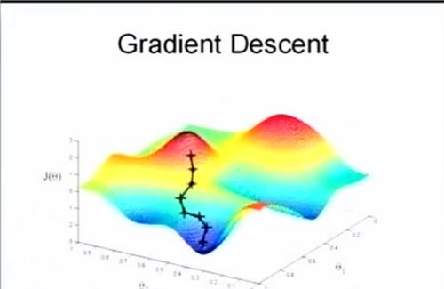
Recap - Optimization
Backpropagation using chain rule allows us to compute gradients for all parameters of deep networks
We use stochastic gradient descent to optimize the network
Stochastic means we use small batches to update the model instead of the whole dataset

Slide 8
Recap – Quick Points
Use ReLU activation function as your primary choice
Carefully search for a good learning rate
Track down useful metrics for your problem

Slide 9
Regularization

Slide 10
Regularization
Is a set of tools for reduction of overfitting
Restricting your model to continue learning the same stuff it has already learnt

Slide 11

L2 Weight Regularization
We add an additional term to our loss function
$$L_{total}\left(y,f\left(x\right),w\right)=L(y,f(x))+\frac{1}{2}λ{\left\|w\right\|}_{2}^{2}=L(y,f(x))+\frac{1}{2}λ\sum_{i=1}^{n_{w}}{w_{i}^{2}}$$
Restricting weights to be more uniform and less spiky
Sum across all weights except biases

Slide 12
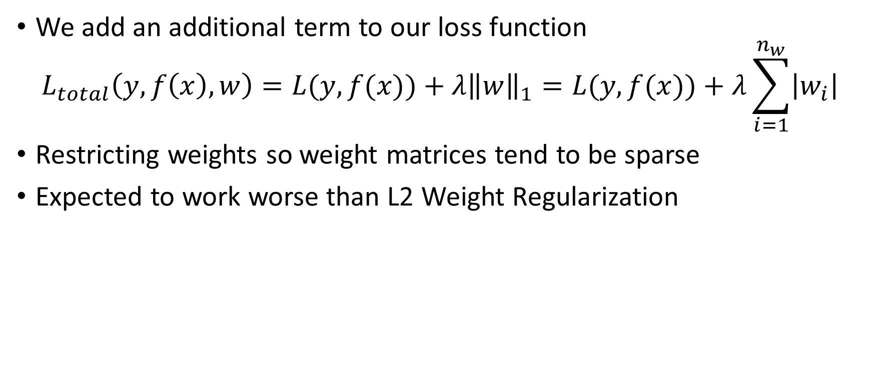
L1 Weight Regularization
We add an additional term to our loss function
$$L_{total}\left(y, f\left(x\right),w\right)=L(y,f(x))+λ{\left\|w\right\|}_{1}=L(y,f(x))+λ\sum_{i=1}^{n_{w}}{\left|w_{i}\right|}$$
Restricting weights so weight matrices tend to be sparse
Expected to work worse than L2 Weight Regularization
Sum across all weights except biases

Slide 13
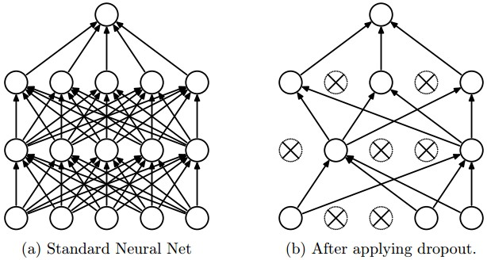
Dropout
Switching off random neurons of the layer with the given probability

Slide 14
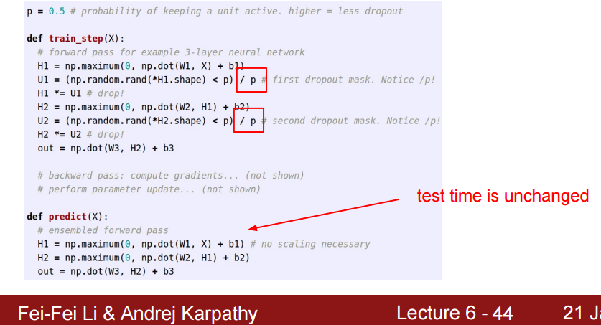

Dropout
We train with dropout and switch it off outside training
For layers with dropout with probability $p$ we scale outputs with $\frac{1}{p}$
We switch off scaling outside training loop

Slide 15
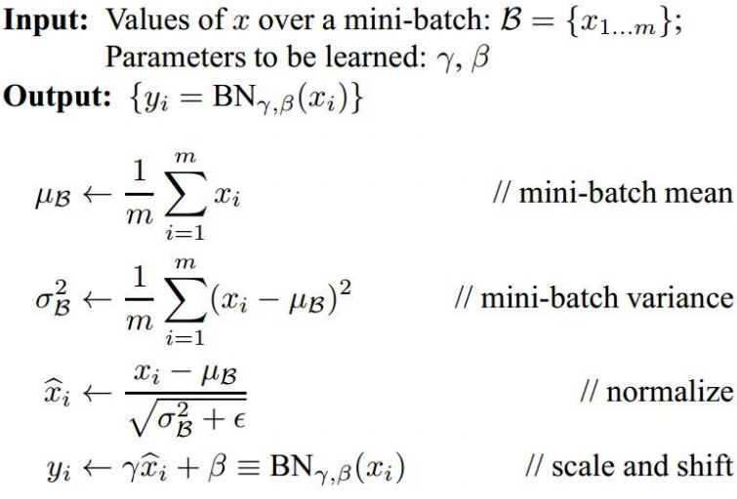
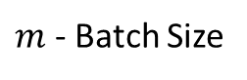
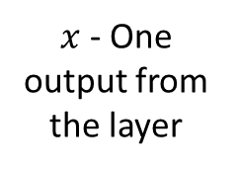
Batch Normalization
$m$ - Batch Size
$x$ - One output from the layer
Output of Batch Normalization
Trained parameters via backpropagation

Slide 16
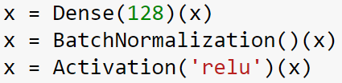
Batch Normalization
Enforces (mostly) unit Gaussian outputs from the neuron
Extremely powerful technique
Decreases training time
Allows using bigger learning rates
Since batch mean and variance can be noisy it regularizes the network a little bit
A rule of thumb: Dense -> Batch Normalization -> Activation

Slide 17
Batch Normalization Outside Training
Not computed from a batch but stored during training as training dataset mean and variance (using exponential moving average)
Freezing these trained parameters after training

Slide 18
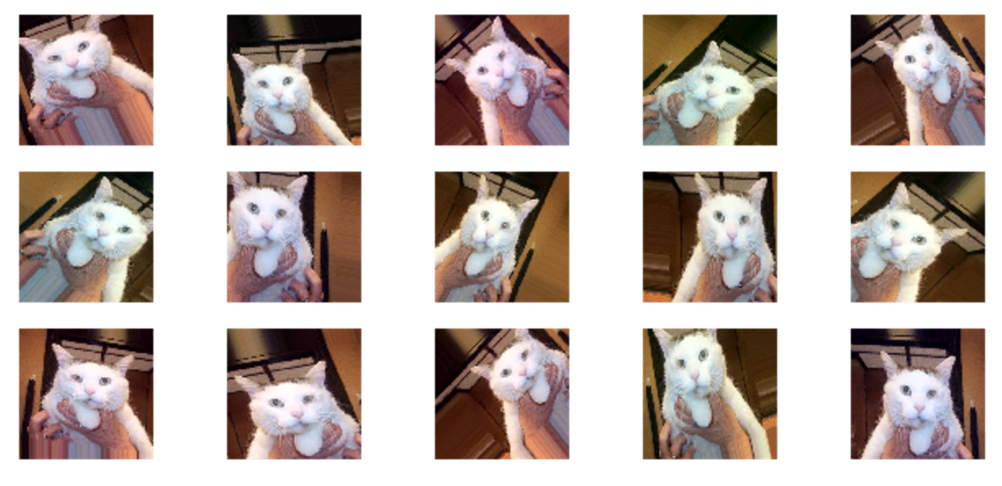
Data Augmentation
Artificially add more data (so NN can learn something new instead of overfitting to the same data)
For images: rotating, scaling, flipping, cropping, etc.
Very specific to your task

Slide 19
Useful Tips for Regularization
Dropout is a powerful technique but makes training longer
Batch Normalization helps a lot but use it before non-linearity
For bigger NNs use L2 Weight regularization
If you have a way to augment your data – go for it

Slide 20
Optimizers

Slide 21
Parameters Optimization
To train neural networks we need to adjust parameters
Optimization to the rescue
We already know how to compute gradients, but how to use them?

Slide 22
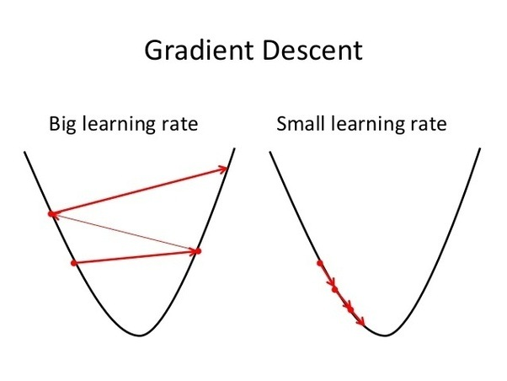
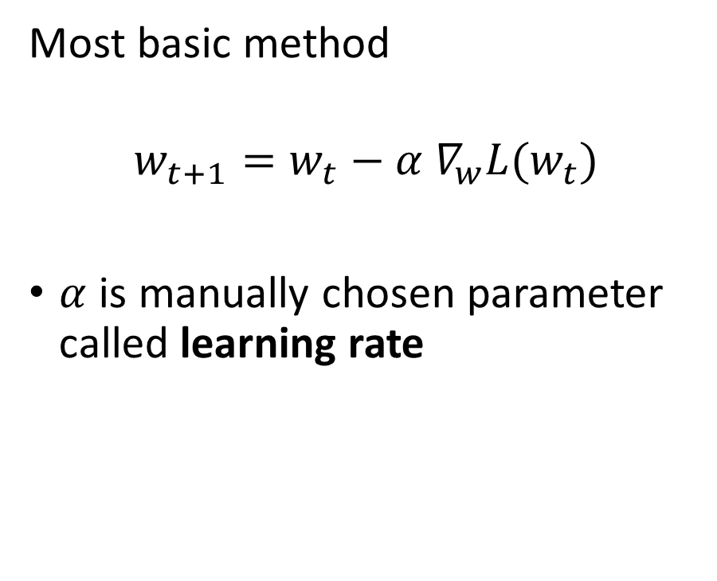
Vanilla gradient descent
Most basic method
$$w_{t+1}=w_{t}−α{ ∇}_{w}L(w_{t})$$
$α$ is manually chosen parameter called learning rate

Slide 23
Gradient descent types
1 update
All data – 1 update:
gradient descent
1 sample – 1 update:
stochastic gradient descent
Batch of samples – 1 update:
mini-batch gradient descent
Train Data
1 update
x
x
x
x
x
x
x
x
x
x
x
x
x
Batch
Batch
Batch
1 Update
1 Update
1 Update

Slide 24
Problems at this point
How to choose learning rate?
Maybe change it during time? But how?
How to avoid suboptimal local minima and saddle points?
How to make it faster?

Slide 25
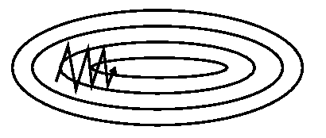
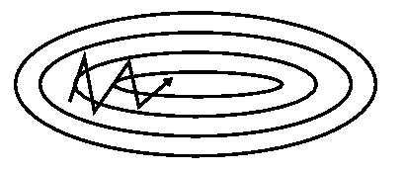
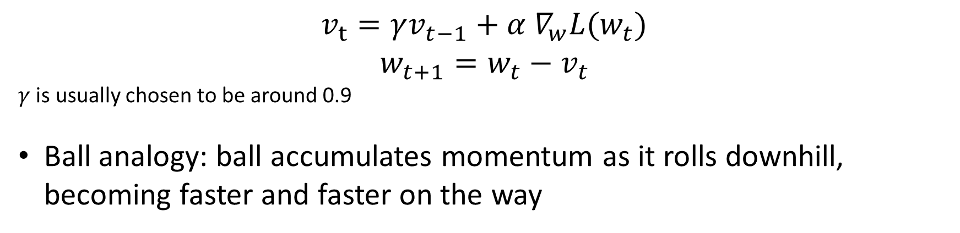
Momentum
Helps to dump oscillations when surface curves much more steeply in one dimension than in another
Without momentum
With momentum
$v_{t}=γv_{t−1}+α{ ∇}_{w}L(w_{t})$
$$w_{t+1}=w_{t}−v_{t}$$
$γ$ is usually chosen to be around 0.9
Ball analogy: ball accumulates momentum as it rolls downhill, becoming faster and faster on the way

Slide 26
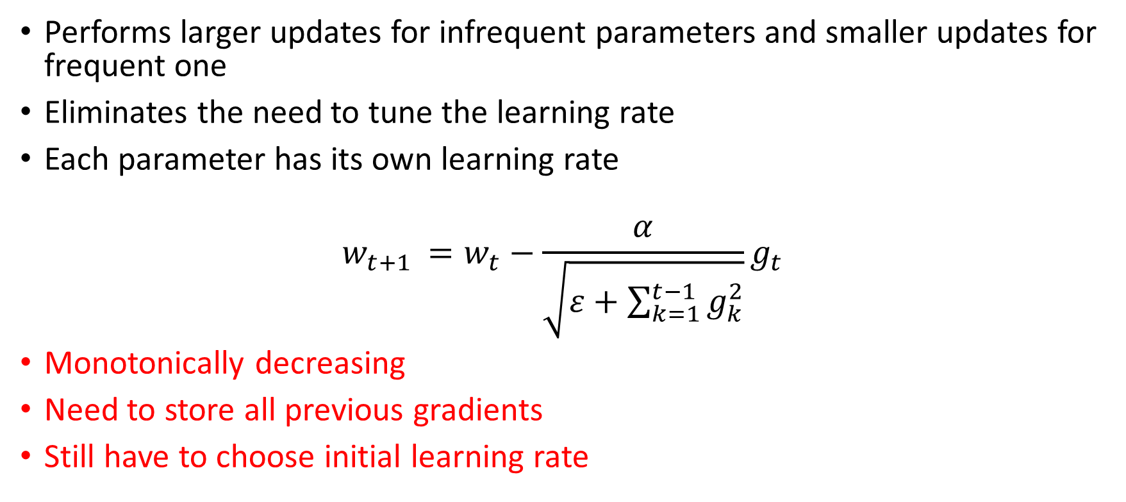
AdaGrad
Performs larger updates for infrequent parameters and smaller updates for frequent one
Eliminates the need to tune the learning rate
Each parameter has its own learning rate
$$w_{t+1 }=w_{t}−\frac{α}{\sqrt{ε+\sum_{k=1}^{t−1}{g_{k}^{2}}}}g_{t}$$
Monotonically decreasing
Need to store all previous gradients
Still have to choose initial learning rate

Slide 27
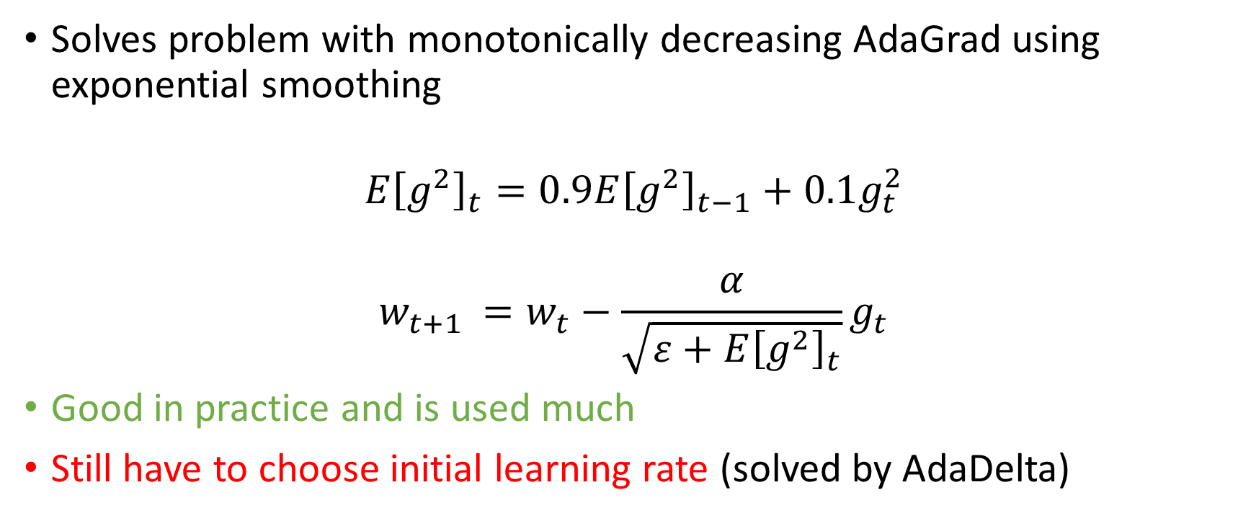
RMSProp
Solves problem with monotonically decreasing AdaGrad using exponential smoothing
$$E{\left[g^{2}\right]}_{t}=0.9E{\left[g^{2}\right]}_{t−1}+0.1g_{t}^{2}$$
$$w_{t+1 }=w_{t}−\frac{α}{\sqrt{ε+E{\left[g^{2}\right]}_{t}}}g_{t}$$
Good in practice and is used much
Still have to choose initial learning rate (solved by AdaDelta)

Slide 28
What’s next?
There are plenty more similar optimization methods:
Nesterov accelerated gradient [advanced Momentum]
AdaDelta [advanced RMSProp]
Adam – use this or RMSprop if you don’t know what to choose
AdaMax
Nadam
To get more details read this awesome article

Slide 29
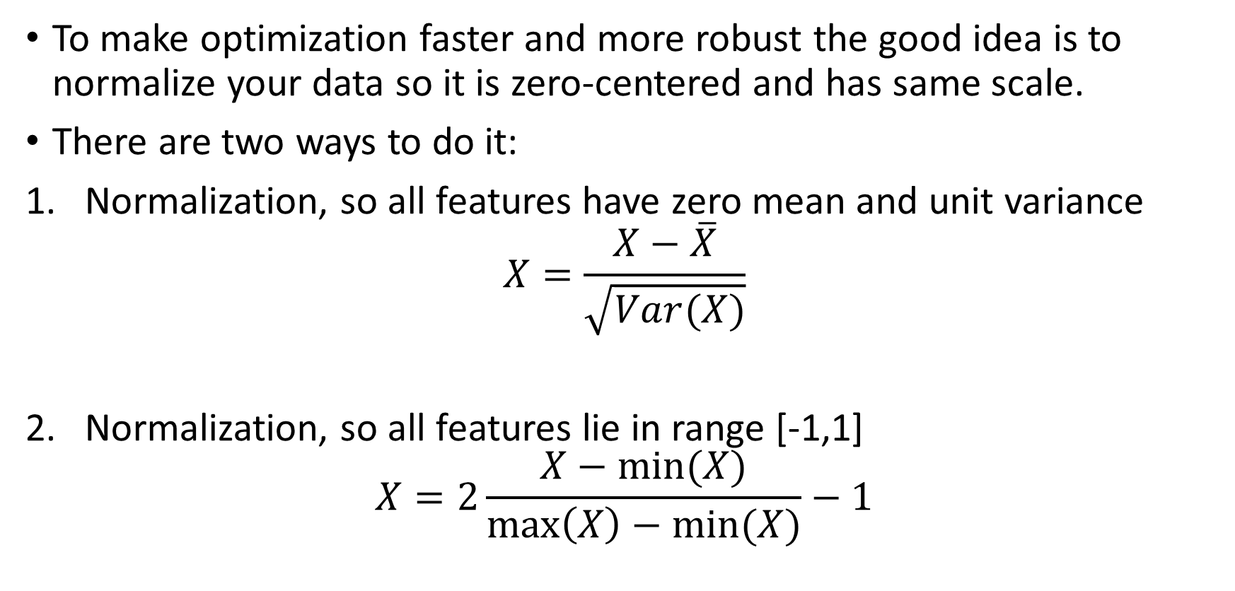
Normalization
To make optimization faster and more robust the good idea is to normalize your data so it is zero-centered and has same scale.
There are two ways to do it:
Normalization, so all features have zero mean and unit variance
$$X=\frac{X−\overline{X}}{\sqrt{Var(X)}}$$
Normalization, so all features lie in range [-1,1]
$$X=2\frac{X−min⁡(X)}{\max\left(X\right)−min⁡(X)}−1$$

Slide 30
Intro to Convolutional NNs

Slide 31
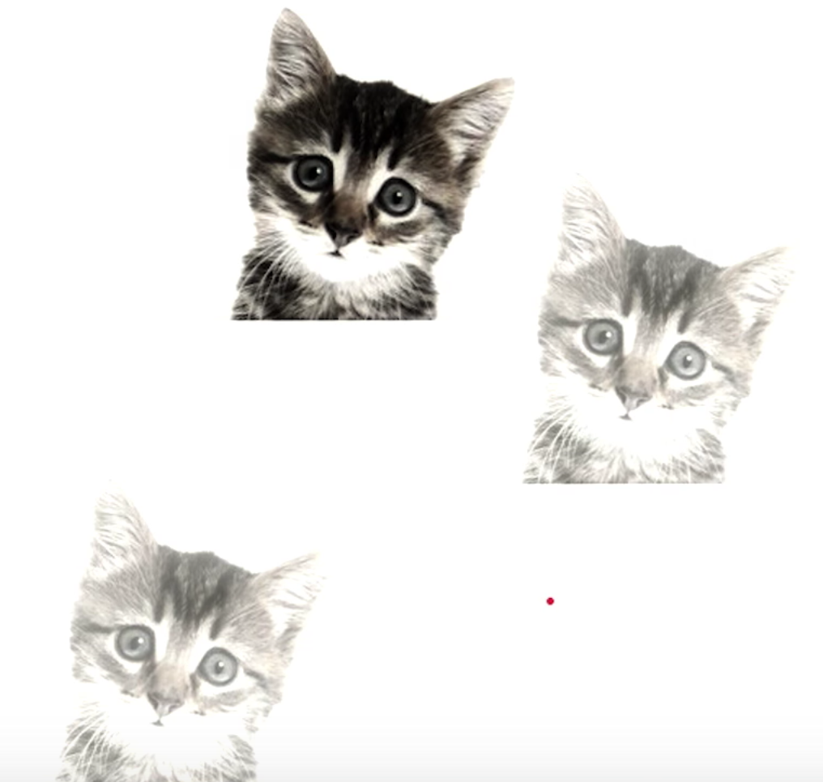
Motivation
Let’s say we have many spatially independent patterns that we want to spot
How do we learn them using Dense Layers?
It’s hard and too data consuming

Slide 32
Motivation
Instead of that, we can learn small filters that are applied across the whole image
These filters called kernels and we use convolutions to apply them to input images
Consider that we have a kernel that fires when it sees a cat face pattern on the image
Then applying convolution to our image with this kernel we obtain a feature map with activations corresponding to cats on the image

Slide 33

Convolution
Initial Image
Feature Map
Applying Kernel that responds to cat face pattern
Kernel fired to the pattern and left big values on the feature map

Slide 34
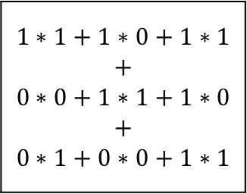

Convolution
$$1∗1+1∗0+1∗1$$ $$+$$ $$0∗0+1∗1+1∗0$$ $$+$$ $$0∗1+0∗0+1∗1$$
$$=4$$
Kernel
(i.e. filter)
has size 3x3
Kernel Values
1 | 0 | 1
0 | 1 | 0
1 | 0 | 1

Slide 35
Convolution
Result of the convolution
Kernel
(i.e. filter)
has size 3x3
Initial Image

Slide 36
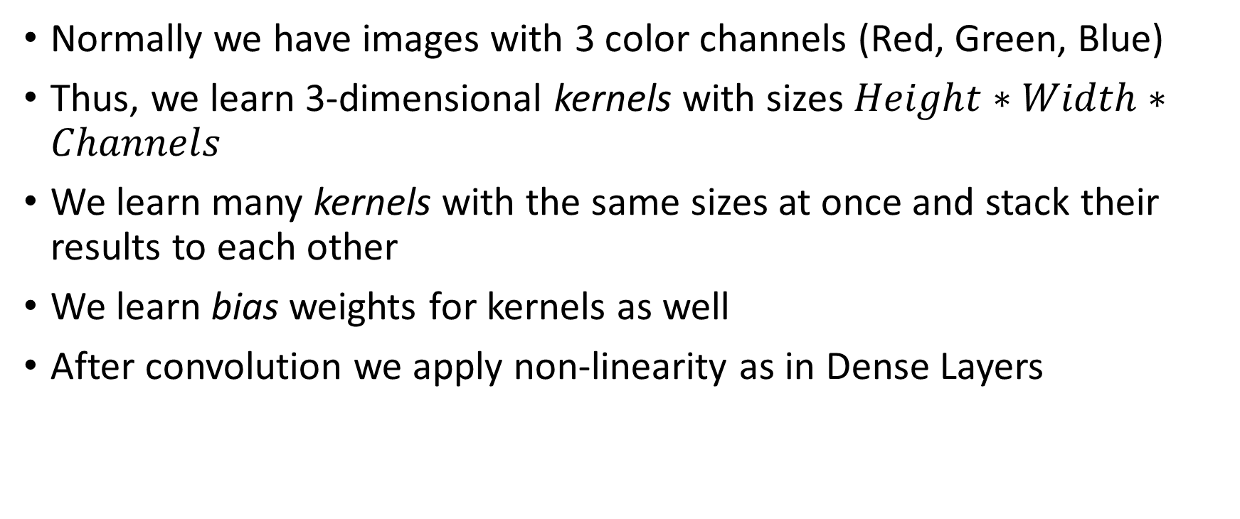
Convolutions with Many Channels
Normally we have images with 3 color channels (Red, Green, Blue)
Thus, we learn 3-dimensional kernels with sizes $Height∗Width∗Channels$
We learn many kernels with the same sizes at once and stack their results to each other
We learn bias weights for kernels as well
After convolution we apply non-linearity as in Dense Layers

Slide 37
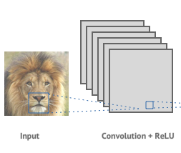
Kernel Channels
We applied 6 different kernels, therefore we obtain 6 feature maps
Now we can treat these 6 feature maps as a new image with 6 channels to pass it further so we can apply new HxWx6 kernels on the next layer
3 color channels for this image (RGB)
Let’s assume that this window has size of 20x20 pixels
Therefore we apply kernels of size 20x20x3 to the image

Slide 38
Convolution – Padding
Result of the convolution has the same size as the input
For filter 3x3 padding of size 1 will result the same output
White part filled with zeros, for instance

Slide 39
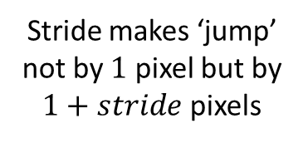
Convolution - Strides
Because of these jumps output image becomes even smaller
Stride makes ‘jump’ not by $1$ pixel but by $1+stride$ pixels

Slide 40
Convolution – Padding and Strides
There is no general rule of how to use padding and strides
Should depend on your problem
Padding and Strides depends on amount of computations
Therefore it also affects time for NN result computation
For the most cases no Stride is used and Padding is either absent or such that the size of the image doesn’t change

Slide 41
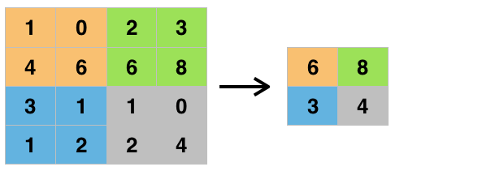
Max Pooling Layers
Getting max value in non-overlapping windows of feature maps
Down sampling feature maps
Reduces overfitting
Reduces number of data to process
Max Pooling window size is set to 2x2

Slide 42
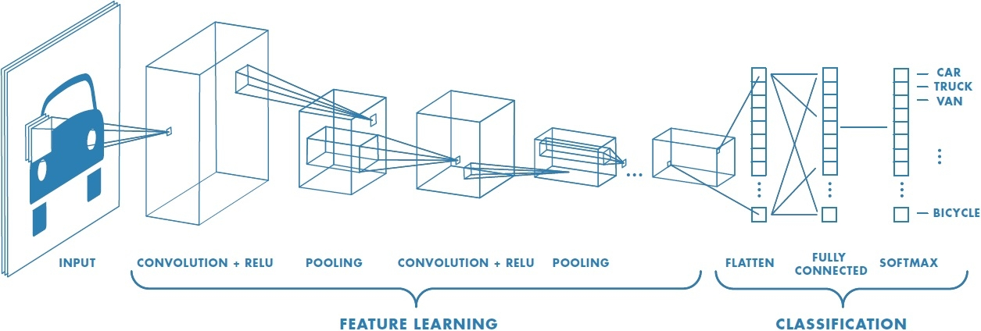
Basic Structure of Deep Convolutional NN
Flattening the feature map – making one shallow vector out of the ‘image’

Slide 43
Recap
We learn small filters (called kernels) that catch useful features and pass them over
We make many layers with such kernels which catch more and more complex features throughout the network
We add Max Pooling layers to add more non-linearity and reduce amount of data to process by NN
At some point we change our feature map into vector with Flattening and proceed as a standard NN

Slide 44
This is It For the Forth Lecture

